Slide 1
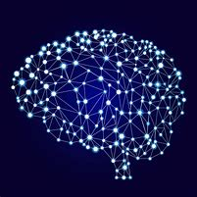
Identification of medicinal plants using deep convolutional networks
Presented By:
1. Vyoma Dixit(170130111022)
2. Parita Brahmbhatt (170130111014)
Guided By: Prof. Suhas Patel

Slide 2
OUTLINE
Introduction
What is Computer Vision?
Flow Diagrams
Tools
Dataset
Training model
Testing model
References

Slide 3
Introduction
How do we get here?
Leaf Identification is a field under the image recognition of computer vision.
Recognizing leaves is the utmost importance in biodiversity conservation.
According to a survey, 80% of Indians use plants as medicine. Hence, it is an important milestone in conserving not just biodiversity but also helpful for accurate identification.
The implementation of the project will be done using Convolutional Neural Networks.

Slide 4
What is computer vision?
computer vision is concerned with the automatic extraction, analysis and understanding of useful information from a single image or a sequence of images.
- The British Machine Vision Association and Society for Pattern Recognition (BMVA)
It is an interdisciplinary field that deals with how computers can be made to gain high-level understanding from digital images or videos.
- Wikipedia

Slide 5
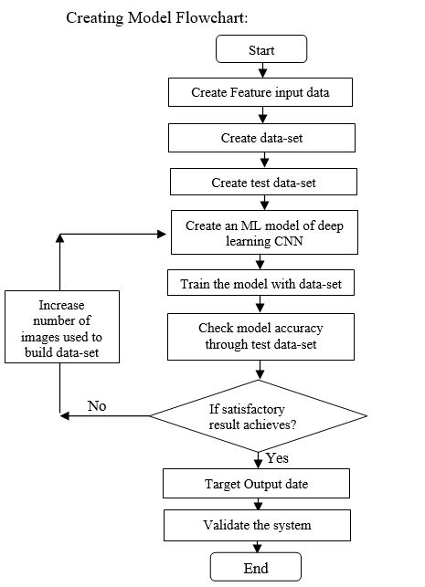
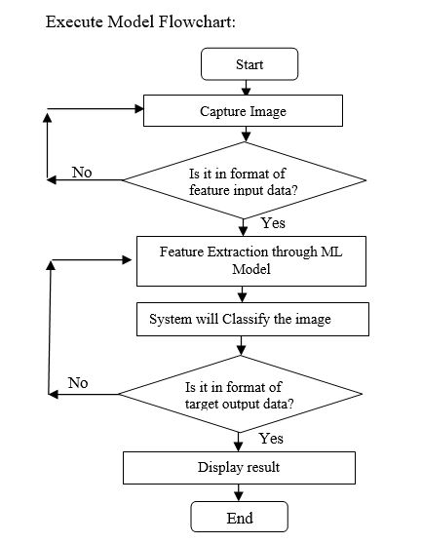
Flow diagrams

Slide 6
tools
Python:
It has strong attributes. Python is very suitable for implementing new ideas. Python is most commonly used for machine learning since its has vast number of open source library.
Python has a bigger community. Therefore there are lots of online resources regarding Python.
Python Image Manipulation and other tools:
NumPy: It is a core library and provides support for arrays.
OpenCV: it is a cross-platform library using which we can develop real-time computer vision applications.
Mahotas: it is also an image processing and computer vision library for python.

Slide 7
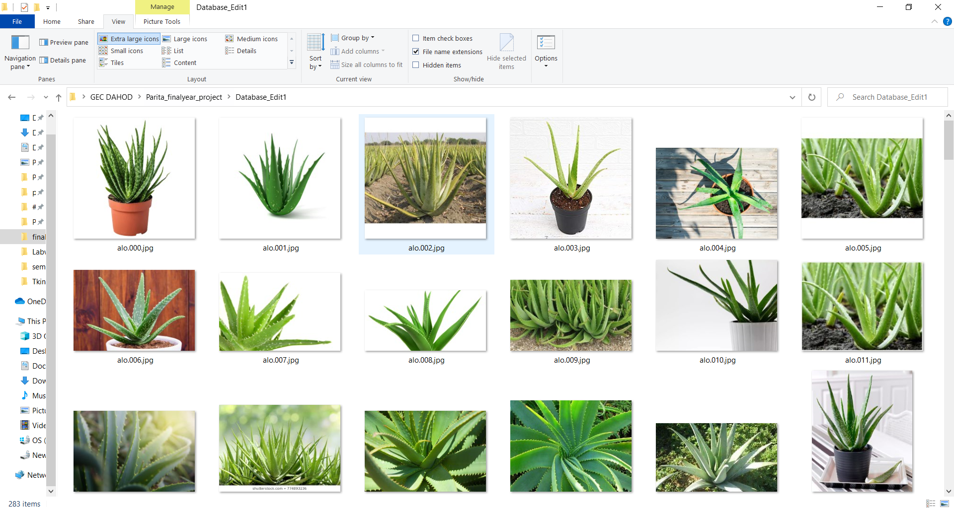
dataset
Approach 1

Slide 8
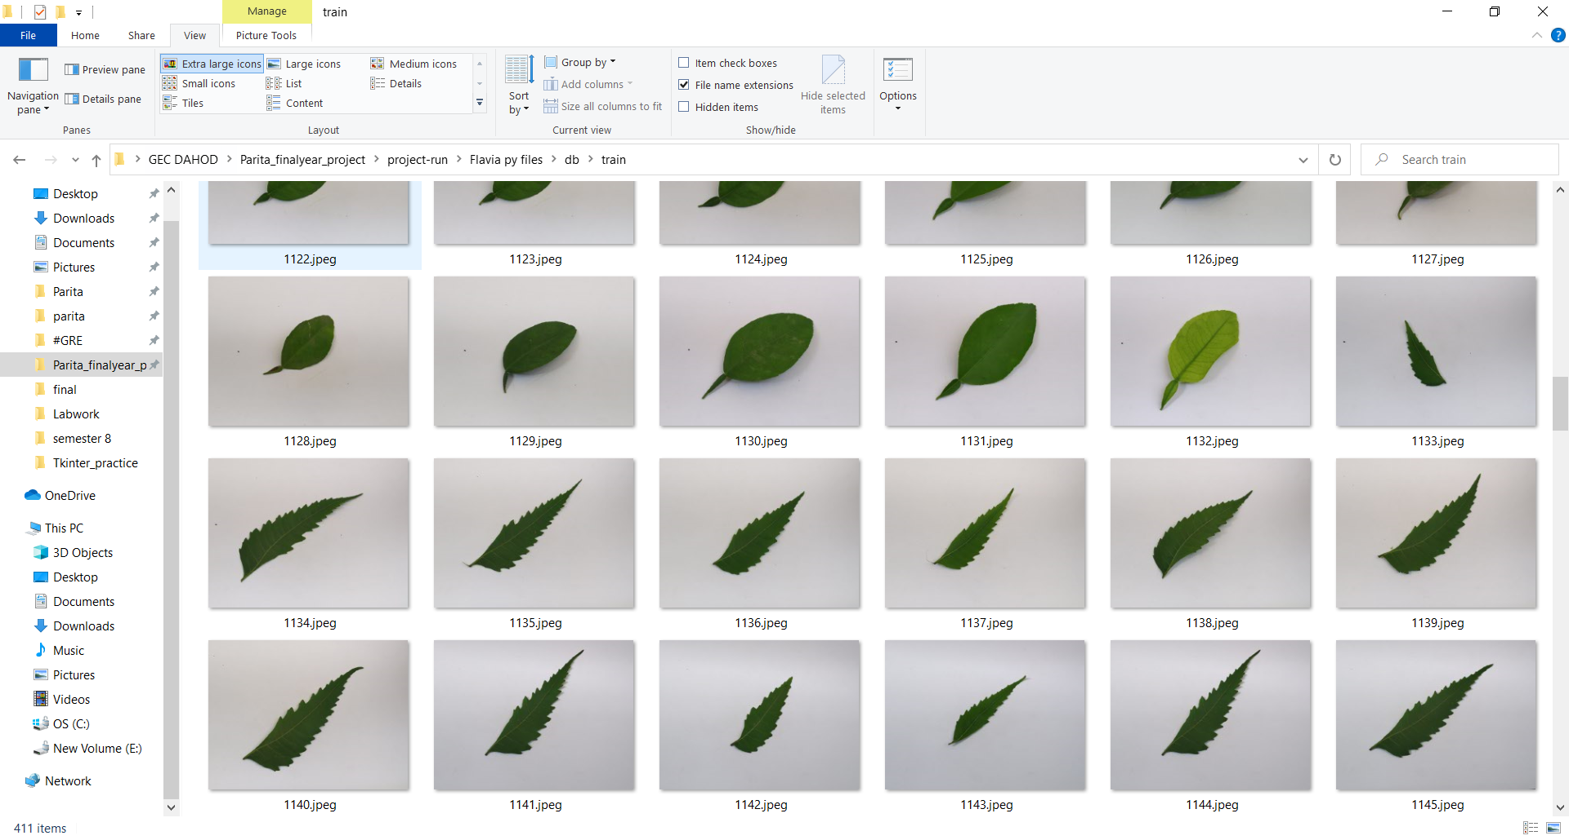
Dataset
Approach 2

Slide 9
Training model
412 images
Six plant species: Nyctanthes Arbor - Tristis , Lemon Leaf, Neem, Basil, Curry leaf, Mango Leaf
Four types of Features: Area and Perimeter
Shape based features
Color features
Texture features

Slide 10
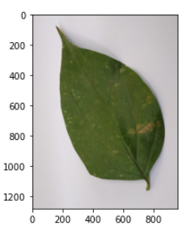
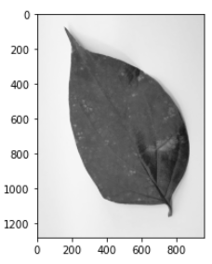
Training model
Step 2: Grayscaling
Step 1: Reading the image

Slide 11
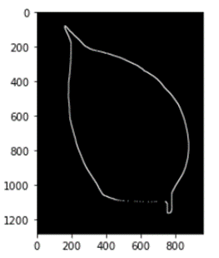
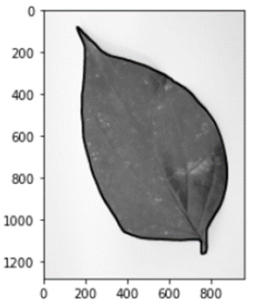
Training model
Step 3: Boundary extraction
Step 4: Image with the Contours

Slide 12
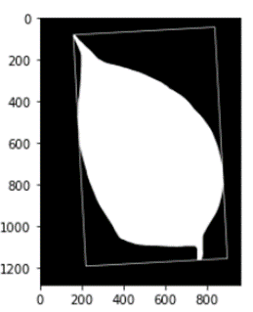
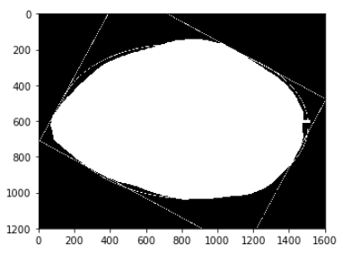
Training model
Step 5: Fitting the best-fit rectangle
Step 6: Fitting the best-fit ellipse

Slide 13
Training model
Step 7: Color based Features
- Mean of red channel
- Mean of green channel
- Mean of blue channel
Step 8: Texture based Features
- Contrast
- Correlationn
- Entropy
- Inverse difference moments

Slide 14
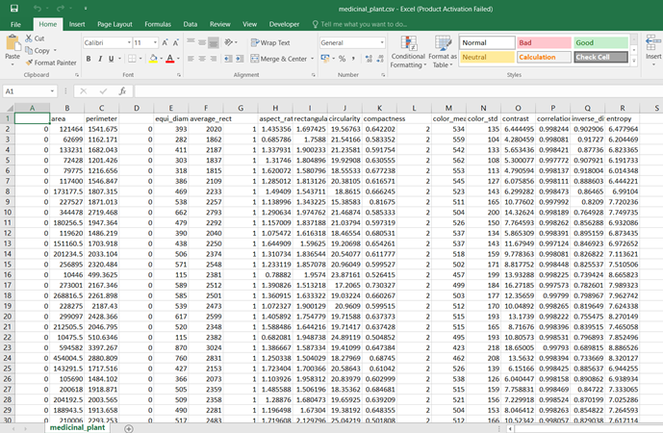
Training model
Step 9: Saving the data into .csv file

Slide 15
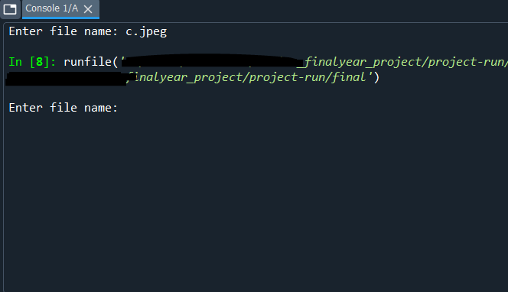
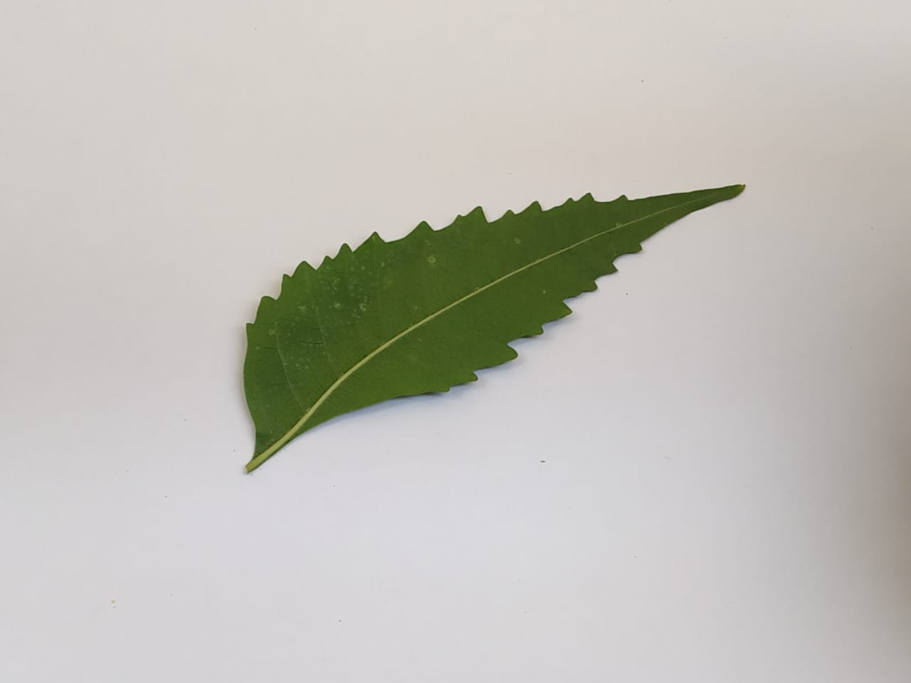
Testing model
Step 1: Defining Break-out points
breakpoints = [1001,1047,1048,1132,1133,1215,1216,1280,1281, 1358,1359,1412]
Step 2: Reading the image from the user

Slide 16
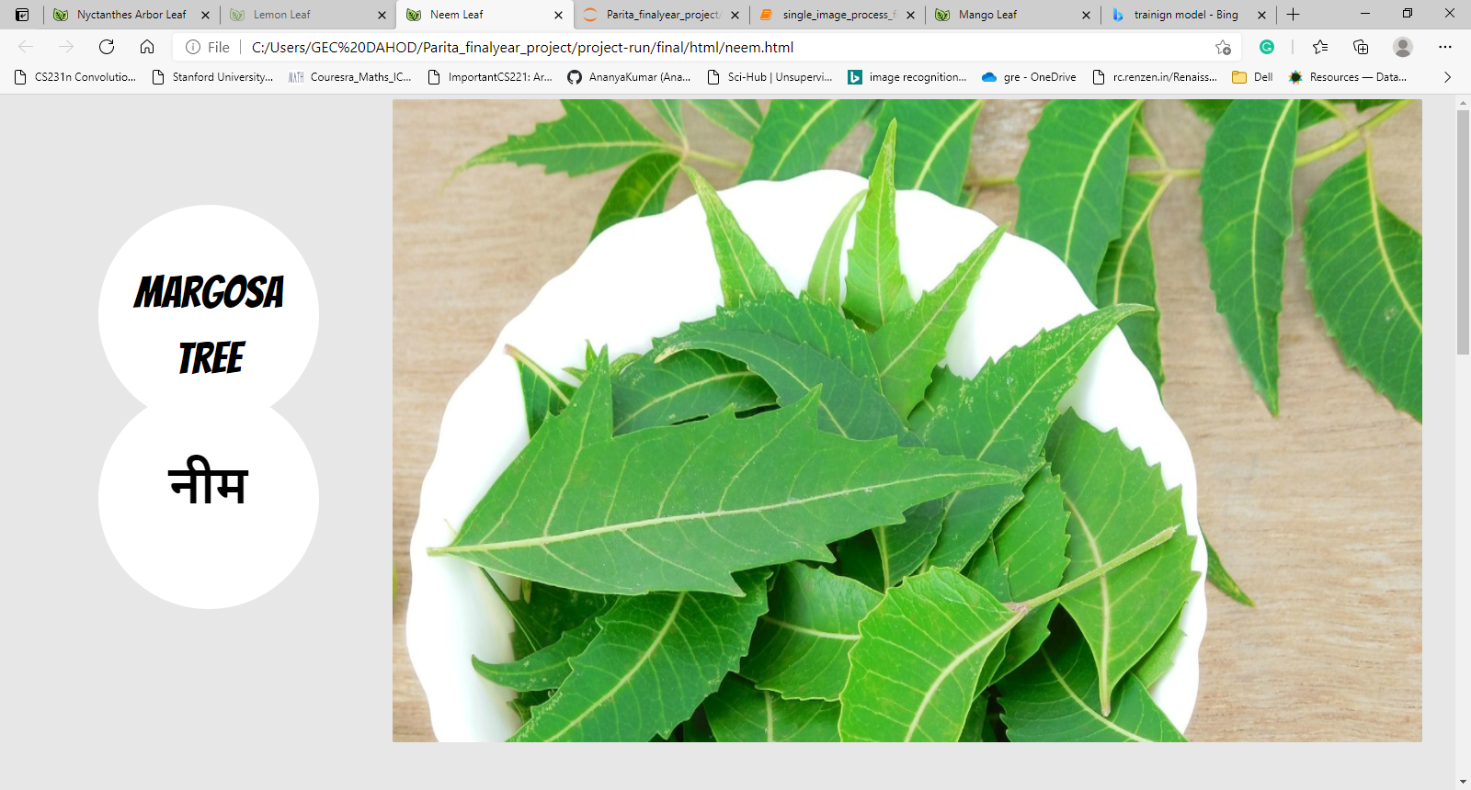
Testing model
Step 3: Feature Extraction
Step 4: Output

Slide 17
references
[1] Plant Leaves Classification: A Few-Shot Learning Method Based on Siamese Network BIN WANG AND DIAN WANG
[2] https://en.wikipedia.org/wiki/Ayurveda
[3] Plant Species Identification Using Computer Vision Techniques: A Systematic Literature Review Jana Wäldchen,Patrick Mäder
[4] Review of Plant Identification Based on Image Processing
[5] Gaston KJ, O’Neill MA (2004) Automated species identification: why not? Philos Trans R Soc Lond B Biol Sci 359(1444):655–667. doi:10.1098/rstb.2003.144
[6] V. Narayan and G. Subbarayan, ‘‘An optimal feature subset selection using GA for leaf classification,’’ Int. Arab J. Inf. Technol., vol. 11, no. 5, pp. 447–451, Sep. 2014. doi: 10.1109/TIT.2014.2344251.
[7] J. Hu, Z. Chen, M. Yang, R. Zhang, and Y. Cui, ‘‘A multiscale fusion convolutional neural network for plant leaf recognition,’’ IEEE Signal Process. Lett., vol. 25, no. 6, pp. 853–857, Jun. 2018. doi: 10.1109/ LSP.2018.2809688
[8] Nayana G. Gavhale1, Dr.A.P.Thakare2 “Identification of Medicinal Plant Using Machine Learning Approach” by International Research Journal of Engineering and Technology (IRJET) e-ISSN: 2395-0056 p-ISSN: 2395-0072
[9] https://www.takingcharge.csh.umn.edu/where-ayurveda-come-from
[10] Mahotas: Computer Vision in Python — mahotas 1.4.3+git documentation
[11] OpenCV Tutorial - Tutorialspoint

Slide 18

THANK YOU!

